Slide 1
Collection, Presentation of Data, and Descriptive Statistics
Unit 2

Slide 2
Data
Data is a collection of facts such as values, observations or measurements.
It can be numbers, words, measurements, observations, or even just descriptions of things.
Basically, data are of two types: constant and variable.

Slide 3
Constant data
Constant is a situation/value that does not change.
Examples: Days of week, months of the year, days in a months, multiplication of 2 numbers, total alphabets, hours in a days, atomic number of elements in periodic table, spelling of numbers or digits, multiplication table, chemical formula of water, equation to find average of n numbers, sin series, cos series.

Slide 4
Variable data
A variable is a characteristic or an attribute that can assume different values in different situations.
Example: height, family size, temperature, result, Profit/loss of an entity, job satisfaction, reading habits, attendance in classroom, GDP, petrol and gold price.
Based on the values that variables assume, variables can be classified as qualitative and quantitative.

Slide 5
Qualitative and Quantitative Variable Data
Qualitative variables are those variables that do not assume numeric values. For example, gender, season, degree, facial expression is qualitative variable. Also known as categorical data.
Quantitative variables are, on the other hand, are those variables which assume numeric values. Height, temperature, blood pressure, family size are examples of quantitative variables. Also known as numeric data.
Quantitative variables are again classified into:
discrete and continuous variables.

Slide 6
Discrete Variable Data
It assumes whole number values and consist of distinct and recognizable individual elements that can be counted.
For example, family size, total admission at college, number of cars at the traffic signal, events organized/attended by faculties, total likes for a tweet, followers on instagram, mails in mailbox.
Their values are obtained by counting .
The values of these variables are obtained by counting (0, 1, 2, ).

Slide 7
Continuous Variable Data
It takes any value including decimals.
These variables can theoretically assume an infinite number of possible values.
Their values are obtained by measuring.
Examples of continuous variables are height, weight, time, temperature, distance between objects.

Slide 8
Exercise
Classify each of the following variables as qualitative and quantitative and if it is quantitative, classify as discrete and continuous.
Color of automobiles in a dealer's show room.
Number of seats in a movie theater.
Classification of patients based on nursing care needed (complete, partial or safers).
Number of tomatoes on each plant on a field.
Weight of newly born babies.
Distance between two tree leaves.

Slide 9
Data Analytics vs Data Analysis
Data analysis is a process involving the collection, manipulation, and examination of data for getting a deep insight.
Data analytics is taking the analyzed data and working on it in a meaningful and useful way to make well-versed business decisions.
Analytics is defined as a process of transforming data into actions through analysis and statistical tool.

Slide 10
Data Analysis
It is special form of data analytics.
Its an approach to analyze or explore the data set to maximize insight into dataset, know the hidden pattern, uncover underlying structure, distribution of data, relationship between features, selecting appropriate model, detect outliers or anomalies, for further analysis.
Various applications are retail, health care, education, electronic media, election poll, entertainment, economy and stocks.

Slide 11
Data Presentation
Two ways to represent the results of exploratory data analysis:
Statistics (non-graphical)
Visualization (graphical)

Slide 12
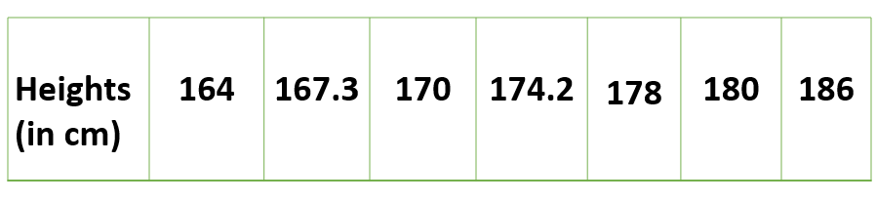
Data analysis -Univariate,bivariate and Multivariate
1. Univariate data –
This type of data consists of only one variable. The analysis of univariate data is thus the simplest form of analysis since the information deals with only one quantity that changes. It does not deal with causes or relationships and the main purpose of the analysis is to describe the data and find patterns that exist within it. The example of a univariate data can be height.

Slide 13
Data analysis -Univariate,bivariate and Multivariate
The description of patterns found in this type of data can be made by drawing conclusions using central tendency measures (mean, median and mode), dispersion or spread of data (range, minimum, maximum, quartiles, variance and standard deviation) and by using frequency distribution tables, histograms, pie charts
2. Bivariate data
This type of data involves two different variables. The analysis of this type of data deals with causes and relationships and the analysis is done to find out the relationship among the two variables. Example of bivariate data can be temperature and ice cream sales in summer season.

Slide 14
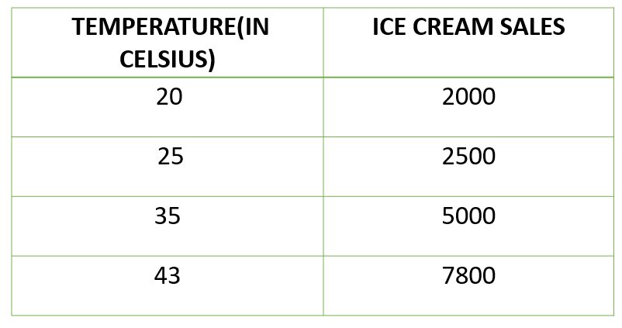
Data analysis -Univariate,bivariate and Multivariate
Suppose the temperature and ice cream sales are the two variables of a bivariate data(figure 2). Here, the relationship is visible from the table that temperature and sales are directly proportional to each other and thus related because as the temperature increases, the sales also increase.

Slide 15
Data analysis -Univariate,bivariate and Multivariate
3. Multivariate data
When the data involves three or more variables, it is categorized under multivariate. Example of this type of data is suppose an advertiser wants to compare the popularity of four advertisements on a website, then their click rates could be measured for both men and women and relationships between variables can then be examined. It is similar to bivariate but contains more than one dependent variable.

Slide 16
Data analysis -Univariate,bivariate and Multivariate
Univariate | Bivariate | Multivariate
It only summarize single variable at a time. | It only summarize two variables | It only summarize more than 2 variables.
It does not deal with causes and relationships. | It does deal with causes and relationships and analysis is done. | It does not deal with causes and relationships and analysis is done.
It does not contain any dependent variable. | It does contain only one dependent variable. | It is similar to bivariate but it contains more than 2 variables.
The main purpose is to describe. | The main purpose is to explain. | The main purpose is to study the relationship among them.

Slide 17
Data Measurement Scales
A scale of measurement shows the information contained in the value of a variable,
and what mathematical operations and statistical analysis are permissible to be done on the values of the variable.
There are four levels of measurement.
These levels, from the weakest to the strongest, in order are:
nominal scale, ordinal scale, interval scale and ratio scale.

Slide 18
Example : Scales of Measurement
Let us take four different situations for a class of 30 students:
Assigning them roll nos. from 1 to 30 in no particular, manner or on random basis so long as no student has more than one number;.
Ask students to stand in a queue as per their heights and assign them position numbers in the queue from 1 to 30;
Conduct a test of 50 marks, for all students and award marks from 0 to 50, as per their performance;
Measure the height and weight of students and make student-wise record.

Slide 19
Situation 1 : Nominal variables
Any student could be assigned No. 1 while any one could be assigned No. 30.
No two students can be compared on the basis of allotment of numbers, in any respect.
The students have been labeled from 1 to 30 in order to give each an identity.

Slide 20
Nominal variables
Variables which show category of individuals.
Number can be given to object for identification.
They reflect classification into mutually exclusive (non-overlapping) and exhaustive categories (name of groups) without any associated ranking.
This scale is the weakest form of measurement.
The only mathematical operation permissible on these variables is counting.

Slide 21
Nominal variables
It is another name for a categorical variable.
have two or more categories without having any kind of natural order.
they are variables with no numeric value.
Numbers may be assigned to the variables simply for coding purposes. It is not possible to compare individuals based on the numbers assigned to categories.
Cannot be assigned any order or cannot be quantified.
In other words, you can’t perform arithmetic operations on them, like addition or subtraction, or logical operations like “equal to” or “greater than” on them.

Slide 22
Examples: Nominal variables
Qualitative:
Gender (Male, Female, Transgender).
Eye color (Blue, Green, Brown, Hazel).
Type of house (Bungalow, Duplex, Ranch).
Type of pet (Dog, Cat, Rodent, Fish, Bird).
Religious preference: Buddhist, Mormon, Muslim, Jewish, Christian, Other.
Political party: BJP, Congress, AAP
Quantitative:
person’s phone number, National Identification Number postal code, aadhar card number etc. are being collected.
1=male, 2=female

Slide 23
Situation 2 : Ordinal variables
Students have been assigned their position numbers in a queue from 1 to 30.
Here the numbering is not arbitrary. The numbers have been assigned according to the height of the students.
So the students are comparable on the basis of their heights, as there is a sequence in this regard. Every subsequent child is taller than the previous one, and so on.
Here the object or event has got its identity. as well as order.
As the difference in height of any two students is not known, so the property of addition of numbers is not applicable to the ordinal scale.

Slide 24
Ordinal variables
Assigns number to objects, but numbers also have some meaningful order.
These are also those variables whose values can be ordered and ranked.
Ranking and counting are the mathematical operations to be done on the values of the variables.
However, these ranks only indicate as to which category greater or better but there is no precise difference between the values (categories) of the variable

Slide 25
Examples: Ordinal variables
grade scores (A, B, C, D, F),
academic qualifications (BE, ME, Ph.D.),
strength (very weak, week, strong, very strong),
health status (very sick, sick, cured).
Satisfaction level(very satisfied, satisfied, dissatisfied)

Slide 26
Situation 3 :Interval variables
Students have been awarded marks from 0 to 50, on the basis of their performance in the test administered on them. Consider the marks obtained by 3 students, which are 30, 20 and 40 respectively.
Here, it may be interpreted that the difference between the performance of the 1st and 2nd student is the same, as between the performance of the 1st and 3rd student.
A student getting 0 marks cannot be described as having zero achievement level.
Similarly, the 2nd student cannot be said to have half the intelligence of the 3rd student, simply because the 2nd has 20 and the 3rd has 40.
Properties of identity, order and additivity are applicable. Scores can also have fractional values.

Slide 27
Interval variables
These are those quantitative variables and identifies not only as to which category is greater or better but also by how much.
Numbers have order as well as equal interval between adjacent categories.
It is the stronger form of measurement but there is no true zero.
Zero indicates low than empty.
Examples: temperature, 0 C does not mean there is no temperature but, rather, it is too cold.
Similarly, if a student scores 0 in a certain course, it does not mean that the student has no knowledge in the course at all.

Slide 28
Situation 4 : Ratio variables
The exact physical values pertaining to the heights and weights of all students have been obtained.
Here the values are comparable in all respect.
If two students have heights of 120 cm and 140 cm, then the difference in their heights is 20 cm and the heights are in the ratio 6:7.
This scale refers to ratio scale.

Slide 29
Ratio variables
These scales are the highest form of measurements.
Ratio variables are those quantitative variables but, unlike the interval variables, zero shows absence of the characteristics.
All mathematical operations are allowed to be operated on the values of these variables.
Examples: height, weight, income, amount of yield,
expenditure, consumption.

Slide 30
Exercise
Jersey number assigned to cricket player
Aadhar card number
Rank order of runners in a race
GTU top 10 students
Top 10 highest tax payers
Temperature in centigrade
Elevation from sea level
height
Age

Slide 31
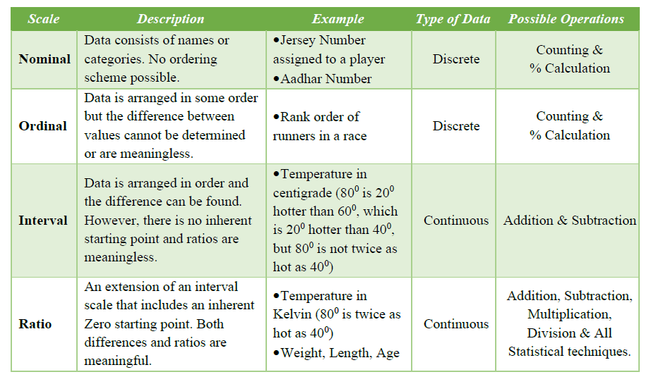
Scale of Measurement

Slide 32
Population and Sample
Population is the set of all possible observations for a given context of problem.
The size of the population is very large.
For Example, eligible voters in election.
Population size of voters may be in millions.
During every election, media and other organizations collect data to predict likely winner of election through opinion polls

Slide 33
Population and Sample
It is very difficult and also practically impossible to collect data from millions of eligible voters about their choice of candidate, so the opinion polls are based on opinion expressed by a subset of voters called sample.
Population (also known as universal set) is the set of all possible data for a given context.
Sample is the subset taken from a population.
An incorrect sample may result in bias and incorrect inference about the population.

Slide 34
Descriptive Statistics
Descriptive statistics refers to a set of methods used to summarize and describe the main features of a dataset, such as its central tendency, variability, and distribution. These methods provide an overview of the data and help identify patterns and relationships.

Slide 35
Descriptive Statistics
Descriptive statistics include the following details about the data
Central Tendency
    Mean – also known as the average
    Median – the center most value of the given dataset
    Mode – The value which appears most frequently in the given dataset
Depending on what exactly you’re trying to describe, you will use a different measure of central tendency. Mean and median can only be used for numerical data. The mode can be used with numerical and nominal data both.
Statistical Dispersion
    Range – Range gives us the understanding of how spread out the given data is
    Variance – It gives us the understanding of how the far the measurements are from the mean.
    Standard deviation – Square root of the variance is standard deviation, also the measurement of how far the data deviate from the mean
Measure of Shape and Symmetry
The Bell Curve – It is a graph of a normal distribution of a variable, it is called a bell curve because of its shape.
    Skewness – It is the measure of the asymmetry of a distribution of a variable about its mean
    Kurtosis – It is the measure of the “tailedness” of a distribution of a variable. It gives us the understanding of how closely the data is spread out.

Slide 36
Measures of Central Tendency
Measures of central tendency are the measures that are used for describing the data using a single value.
Measures of central tendency help users to summarize and comprehend the data.
Computed averages:
Mean and mode are the measures of central tendency and are frequently used to compare different data sets.
Positional averages:
Median and Quantiles(Quartiles, Deciles and Percentiles)

Slide 37
Mean : Arithmetic Mean
Simple arithmetic mean:
The arithmetic mean is the simplest but most useful
measure of central tendency.
It is nothing but the 'average‘. It is defined as the sum of all observations divided by the total number of observations.
The sample mean is denoted by x̅ (read as X bar)
While the population mean is represented by the Greek letter ,μ.

Slide 38
Individual observations
For a sample of n raw (individual) observations, X1, X2,…,Xn:
Example : Find the arithmetic mean of 2, 4 and 8.

Slide 39
Mode
Mode is another measure of central tendency. It is a value of a particular type of items which occur most frequently.
For instance if shoe size 7 has the maximum demand, size No. 7 is the modal value of shoe sizes. Mode is denoted by ^X .
A data set may have one mode (uni-modal), two modes (bi-modal), more than two modes (multi-modal) or no mode at all (i.e. when all observations are equally frequent).

Slide 40
Mode
In ungrouped (individual series) cases, one can find mode by inspection. After arranging the data in ascending or descending order, the value appearing most frequently (the most frequent value) is taken as the modal value.

Slide 41
Mode
Find the mode of the following data sets.
a. 110, 113, 116, 116, 118, 118, 118, 121 and 123.
Since 118 occurs more than other values, the mode is 118.
2, 3, 5, 7 and 8.
Each value occurs once (equally frequent), the data has no mode.
15, 18, 18, 18, 20, 22, 24, 24, 24, 26 and 26
18 and 24 occur three times, hence the modal values are 18 and 24 (bi-modal).
5, 6, 6, 7, 9, 9, 10, 12 and 12.
Tri-modal (multi-modal): 6, 9 and 12.

Slide 42
Median
Median is the half way point in a data set.
It divides a data set into two equal parts
such that half of the numbers have a value less than the median and
half will have values greater than the median.
Graphically, median is located at the intersection point of the less than and more than cumulative frequency curves.

Slide 43
Median
The median (denoted by ˜X ) of a set of n observations X1, X2,…,Xn, arranged in ascending or descending order of magnitude is the middle value if n is odd or the arithmetic mean of the two middle values if n is even.
That is:

Slide 44
Median
Find the median of the following two data sets:
a. 180, 201, 220, 191, 219, 209 and 220.
b. 62, 63, 64, 65, 66, 66, 68 and 78
Using the formula for raw data:
a. 4th value=209
b. (4th value + 5th value)/2=(65+66)/2=65.5
180,191,201,209,219,220,220
a. 4th value=209

Slide 45
Other Measures of Location : Quantiles
Median divides a given data set into two equal parts.
There are also other positional measures that divide a given data set into more than two equal parts.
These measures are collectively known as quantiles.
Quantiles include quartiles, deciles and percentiles.
For all of these measures, first, the data should be arranged in ascending order.

Slide 46
Quartiles
Quartiles are values that divide a data set into four equal parts.
These values are denoted by Q1, Q2 and Q3 such that 25% of the data fall below Q1, 50% below Q2 and 75% below Q3.
Let Qi be the ith quartile (i = 1; 2; 3), then

Slide 47
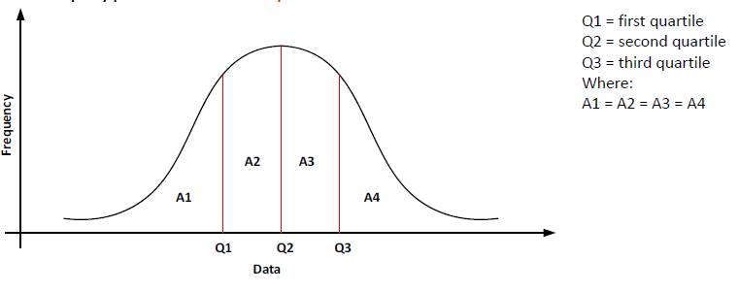
Quartiles

Slide 48
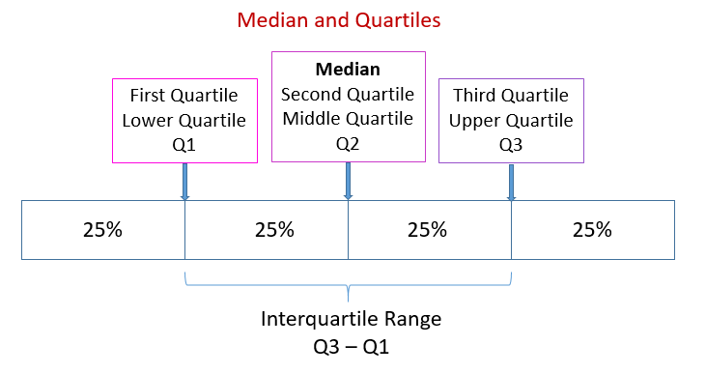
Quartiles

Slide 49
Quartiles
Given the data: 420, 430, 435, 438, 441, 449, 490, 500, 510 and 515. Find all the quartiles.

Slide 50
Deciles
Deciles are values that divide the data into ten equal parts.
These values are denoted by D1, D2,…, D9 such that 10% of the data fall below D1, 20% below D2, , 90% below D9.
Let Di be the ith decile (i = 1, 2,…, 9), then

Slide 51
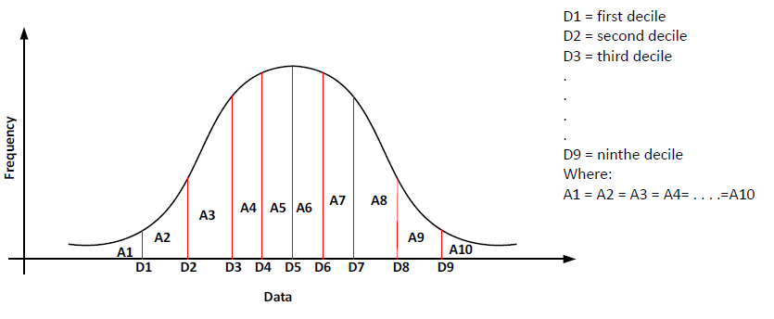
Deciles

Slide 52
Deciles
Given the data: 420, 430, 435, 438, 441, 449, 490, 500, 510 and 515. Find the 1st and 7th deciles.

Slide 53
Percentiles
Percentiles are values that divide a data set into 100 equal parts. These values are denoted by P1, P2,…, P99.
Let Pi be the ith percentile (i = 1, 2,…, 99), then

Slide 54
Percentiles
Given the data: 420, 430, 435, 438, 441, 449, 490, 500, 510 and 515. Find the 40th and 75th percentiles.

Slide 55
Relationship between Median, Quartiles, Deciles and Percentiles

Slide 56
Measures of Variation
In the previous topic , we concentrated on central values (measures of central tendency), which gives an idea of the whole mass, that is, a complete set of values
However, the information so obtained is neither exhaustive nor comprehensive,
these measures do not reveal how the values are spread (dispersed or scattered) on each side of the central value.

Slide 57
as the mean does not lead us to know whether the observations are close to each other or far apart.
Median is a positional average and has nothing to do with the variability of the observations in a data set.
This leads as to conclude that a measure of central tendency is not enough to have a clear idea about the data unless all observations are the same.
Moreover, two or more data sets may have the same mean and/or median but they may be quite different.

Slide 58
measures of central tendency
The following table displays the price of a certain commodity in four cities. Find the mean and median prices of the four cities and interpret it.

Slide 59
measures of central tendency
All the four data sets have mean 30 and median is also 30.
But by inspection it is apparent that the four data sets differ remarkably from one another.
So measures of central tendency alone do not provide enough information about the nature of the data.
Thus, to have a clear picture of the data, one needs to have a measure of dispersion or variability among observations in the data set.

Slide 60
measure of dispersion
Variation or dispersion may be defined as the extent of scatteredness of value around the measures of central tendency.
Thus, a measure of dispersion tells us the extent to which the values of a variable vary about the measure of central tendency.
Dispersion is the amount of variation, scatter or spread in data. A measure of dispersion is a value which indicates the degree of variability of data.

Slide 61
Objectives of Measures of Variation
To have an idea about the reliability of the measures of central tendency.
To compare two or more sets of data with regard to their variability.
To provide information about the structure of the data.
To pave way to the use of other statistical measures.

Slide 62
Types of Measures of Variation
Absolute Measures of Variation: It shows the actual amount of variation of an item from a measure of central tendency and are expressed in concrete units in which the data have been expressed.
Range, Quartile Deviation, Mean Deviation, Variance and Standard Deviation.

Slide 63
Types of Measures of Variation
Relative Measures of Variation: It is the quotient obtained by dividing the absolute measure by a quantity in respect to which absolute deviation has been computed. It is a unit less pure number and used for making comparisons between different distributions.
Coefficient of Range, Coefficient of Quartile Deviation, Coefficient of Mean Deviation, Coefficient of Variation, Standard Scores.

Slide 64
Measures of Variation or Deviation
Range: The range of a set of data is the difference between the largest and lowest observed values in a data set or the interval between these values.
It is a measure of the spread of the data.
For example, the range of 2, 3, 3, 5, 7, and 10 is 8, i.e 10-2.
Variance: It is a measure of variability based on the squared deviation of the observed values in the data set from its mean.
Since variance is the average of the squared deviation from the mean, it is also called the Mean Square Average.

Slide 65
Measures of Variation or Deviation
Standard Deviation: Or Root Mean Square Deviation is a kind of average of the deviations from the mean.
It is defined as the root mean square value of the differences of individual elements from the arithmetic mean.
SD is nothing but the positive square root of the variance.
Coefficient of Variation (CV) : It is a statistical measure of the dispersion of data points in a data series around the mean.
It represents the ratio of the standard deviation to the mean, and it is a useful statistic for comparing the degree of variation from one data series to another, even if the means are drastically different from one another.

Slide 66
Variance and Standard Deviation
Variance and standard deviation are the most superior and widely used measures of dispersions
and both measure the average dispersion of the observations around the mean.
The variance of a data set is the sum of the squares of the deviation of each observation taken from the mean divided by total number of observations in the data set.
The positive square root of variance is called standard deviation.

Slide 67
Variance and Standard Deviation
For a population containing N elements, the population standard deviation is denoted byσ
the Greek letter (sigma) and hence the population variance is denoted by σ².

Slide 68
Variance and Standard Deviation
For a sample of n elements, the sample variance and standard deviation denoted by S and S², respectively, are calculated as using the formulae:

Slide 69
Variance and Standard Deviation
Find the variance and standard deviation of: 20, 28, 40, 12, 30, 15 and 50.
a. Take the data as a population.
b. Consider it as a sample.

Slide 70
Variance and Standard Deviation

Slide 71
Variance and Standard Deviation

Slide 72
MEASURES OF SYMMETRY AND SHAPE
The measure of central tendency and dispersion can describe the distribution but they are not sufficient to describe the nature of the distribution.
For this purpose, we use other concepts known as Skewness and Kurtosis.

Slide 73
Skewness
It is third moment of ditribution.
It is a measure of asymmetry of a distribution.
It represents the shape of the distribution.

Slide 74
Skewness
Skewness: means lack of symmetry.
A distribution is said to be symmetrical or normal when values are uniformly distributed around mean.
In a symmetrical distribution the mean, median and mode coincide, that is, mean = median = mode.
Several measures are used to express the direction and extent of skewness of a dispersion.
The first one is the Coefficient of Skewness:

Slide 75
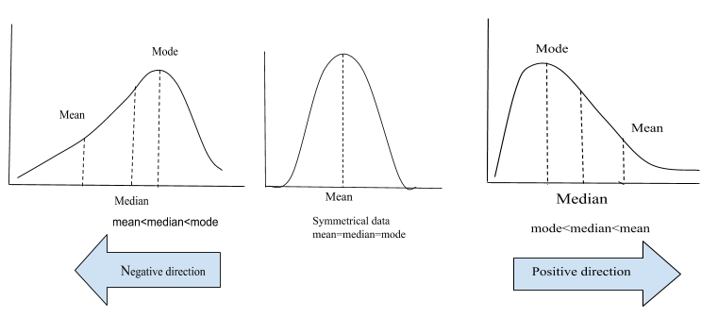
Normal Skewness
For a symmetric distribution Sk = 0.
The range for Sk is from -3 to 3.
The mode, the mean and the median have the same value in a normal curve.

Slide 76
Frequency Curves :
Symmetric/Normal curve
A symmetric curve is a frequency curve when it looks the same to the left and right of the central point.
The distribution spread around a central tendency value in a symmetrical and bell shaped pattern.
The lengths of both tails are the same.
The mean, median and modal values are approximately equal.
The corresponding pairs of quartiles, deciles and percentiles are equi-distance from the median.
For example, first quartile and third quartile have the same distance from the median.

Slide 77
Symmetric/Normal curve

Slide 78
Positive Skewnwss
When the value of the skewness is positive, the tail of the distribution is longer towards the right hand side of the curve.
Mass of distribution is concentrated on the right.
It is a right-leaning curve.
if it is positively skewed then Sk is positive.
The median and the mean lie to the right of the mode in the same direction of the skewness in the positively skewed curve.
In other words the mean and the median are greater than the mode.

Slide 79
Frequency Curves :
Positively skewed curve
If some observations are extremely large, the mean of the distribution becomes greater than the median or mode.
In such case, the distribution is said to be positively skewed. In positively skewed distribution:
The right tail of the frequency curve is more elongated, longest tail to the right of the central point.
More values are on the left of the mean.
The extreme variation is towards large values (to the right). Smaller values are more frequent.
Mean>Median>Mode

Slide 80
Positively skewed curve

Slide 81
Negative skewness
When the value of the skewness is negative, the tail of the distribution is longer towards the left hand side of the curve.
Mass of distribution is concentrated on the left.
It is a left-leaning curve.
If the distribution is negatively skewed then Sk is negative and
In the negatively skewed curve the median and the mean lie to the left of the mode.
In other words the mean and the median are less than the mode.

Slide 82
Frequency Curves :
Negatively skewed curve
If some extremely small observations are present, the mean is the smallest of the the other two averages, and the distribution is said to be negatively skewed.
The left tail is more elongated.
More observations are concentrated on the right of the mean.
The extreme variation is towards lower values (to the left).
Larger values are more frequent than small values
Mean<Median<Mode

Slide 83
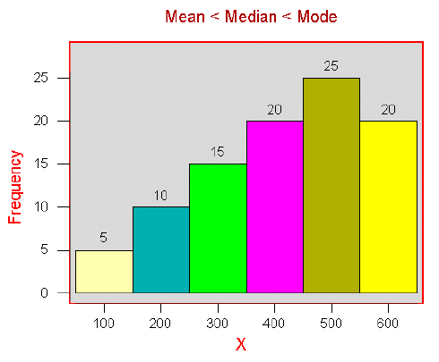
Negatively skewed curve

Slide 84
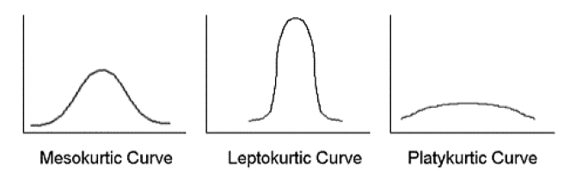
Kurtosis
It is a measure of the peakness or convexity of a curve is known as Kurtosis.
It is derived from Greek word Kyrtos means curved.
It is the degree of flatness or peakness in the region around the mode of the frequency curve.
A positive value tells you that you have heavy tails (a lot of data in your tails) and a negative value means that light-tails (little data in your tails).

Slide 85
Kurtosis
(i) Distribution in which value of observations clusters heavily in the centre is peaked or leptokurtic. Lepto means thin. It has thinner tails.
A distribution with kurtosis >3 (excess kurtosis >0).
(ii) Flat distribution, with values of observations more evenly distributed and tails flatter than the normal distribution is called platykurtic. Platy means flat.
A distribution with kurtosis <3 (excess kurtosis <0). Platy mean flat.
(iii) A distribution that is almost normal, neither too peaked not too flat, is called mesokurtic.
A normal distribution has kurtosis exactly 3 (excess kurtosis exactly 0).

Slide 86
Kurtosis
The quantitative indices of kurtosis of a distribution can be calculated using the semi-inter quartile range and the nintieth and tenth percentiles.
This index is symbolized by the Greek letter K(Kappa) and is given by

Slide 87
leptokurtic

Slide 88
platykurtic

Slide 89
mesokurtic

Slide 90
Different Measurement of data
Scale of Measurement of data:
(nominal, ordinal, Interval, ratio)
Measurement of central tendency(computational):
Mean(arithmetic, geometric, progressive, harmonic)
Measurement of central tendency(positional) or Measure of center of location:
Quantiles(median, quartiles, deciles, percentiles), mode
Measure of deviation or variation :
Range, variance and standard deviation
Measure of symmetry and shape :
Skewness and Kurtosis

Slide 91
Moments [of Statistical Distribution]
The shape of any distribution can be described by its various ‘moments’. The first four are:
1) The mean, which indicates the central tendency of a distribution.
2) The second moment is the variance, which indicates the width or deviation.
3) The third moment is the coefficient of skewness, which indicates any asymmetric ‘leaning’ to either left or right.
4) The fourth moment is the coefficient of Kurtosis, which indicates the degree of central ‘peakedness’ or, equivalently, the ‘fatness’ of the outer tails.

